Slide 1


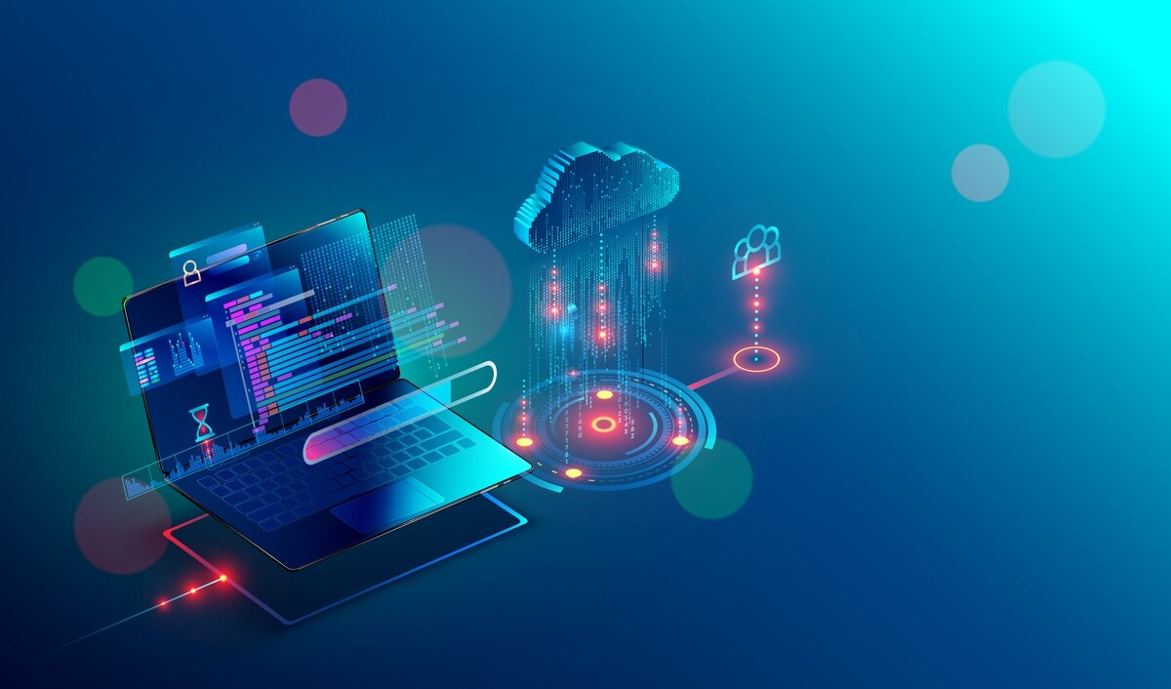
Network control
Supervisor
Dr. Mohmed Abed Fayez
By
Soaud Walid Ali & Ibrahim Ali Alkharbash

Slide 2
PROJECT IDEA
The idea of NCP project

Slide 3
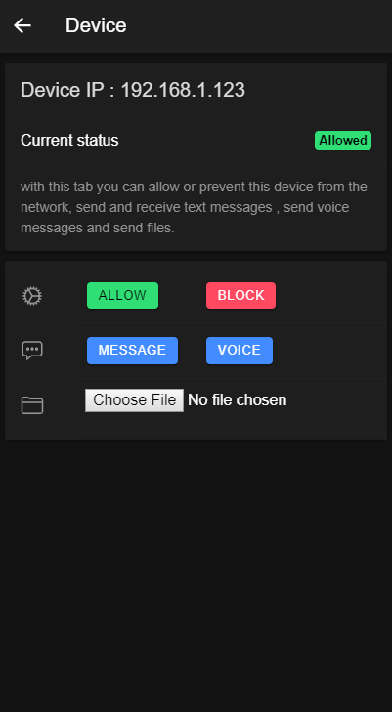
What is NCP?
Application to:
Find connected device to the network.
Control network access.
Send and receive messages to clients.
Stream voice.
Upload files to clients

Slide 4
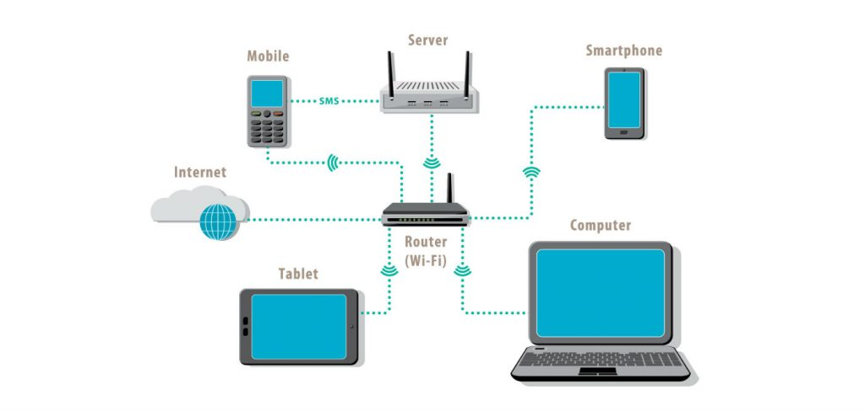
Local Network:
LAN vs WAN.
Wired LAN vs Wireless LAN.
Connection specs.
Ip addresses.

Slide 5
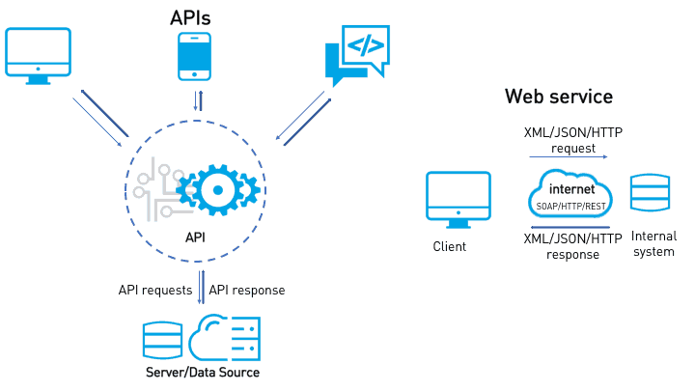
Web API:
What is API!
How it works!
HTTP requests.
Server vs Client.
JSON VS XML

Slide 6
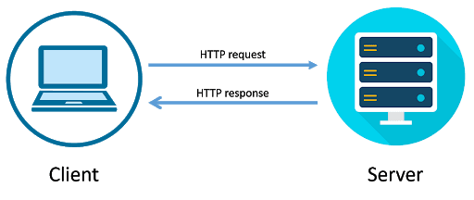
HTTP Requests:
What is HTTP request!
HTTP Headers.
HTTP Body.
HTTP methods(GET, PUT, POST, DELETE).
HTTP router.

Slide 7
RELATED WORK
Similar apps available

Slide 8
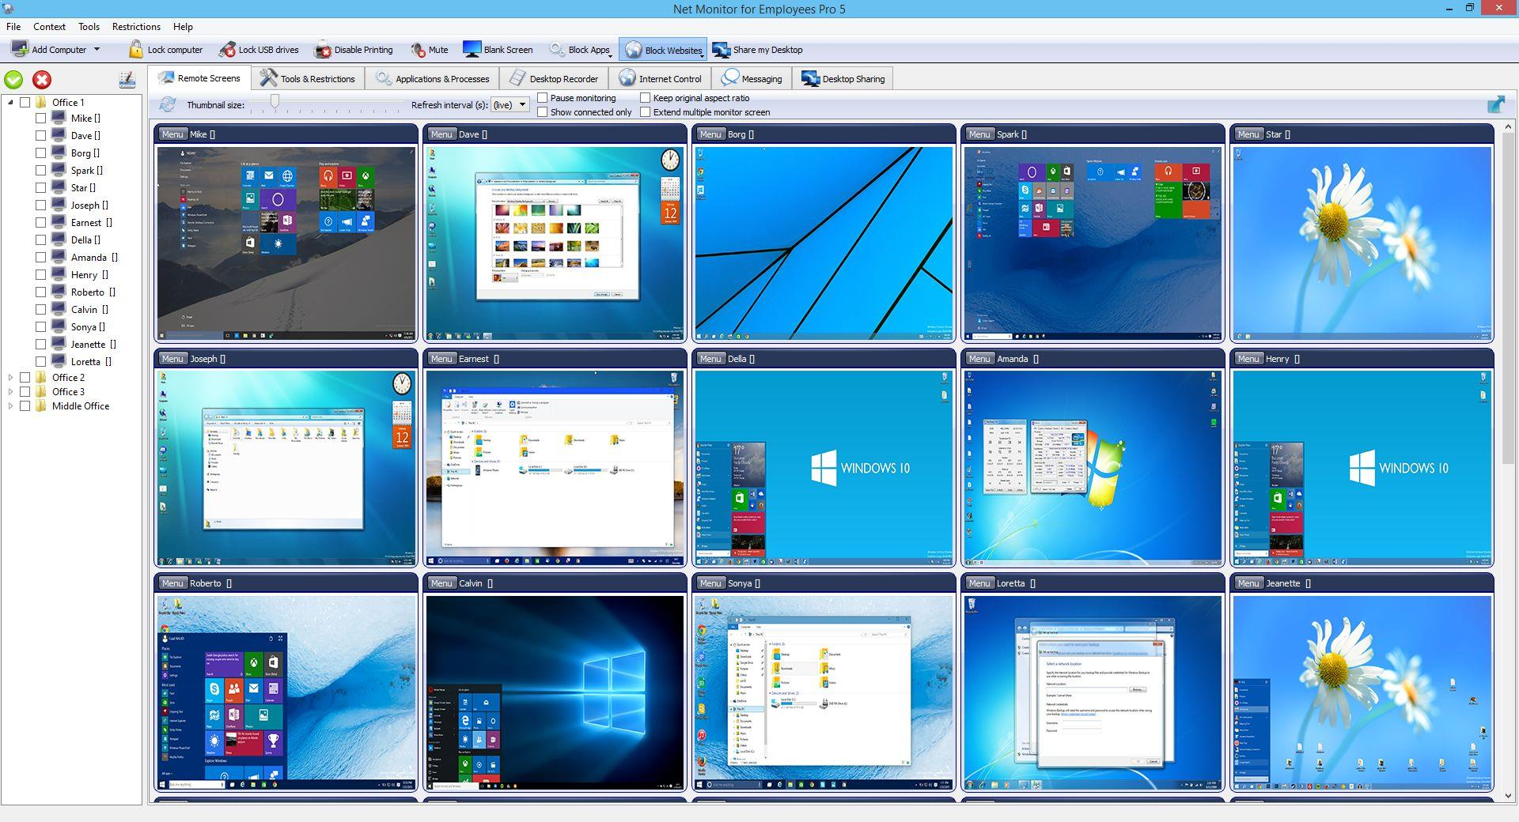
Net Monitor for Employees:
Desktop App.
Offers remote desktop.
Control some OS parameters.
Provide cloud services.

Slide 9
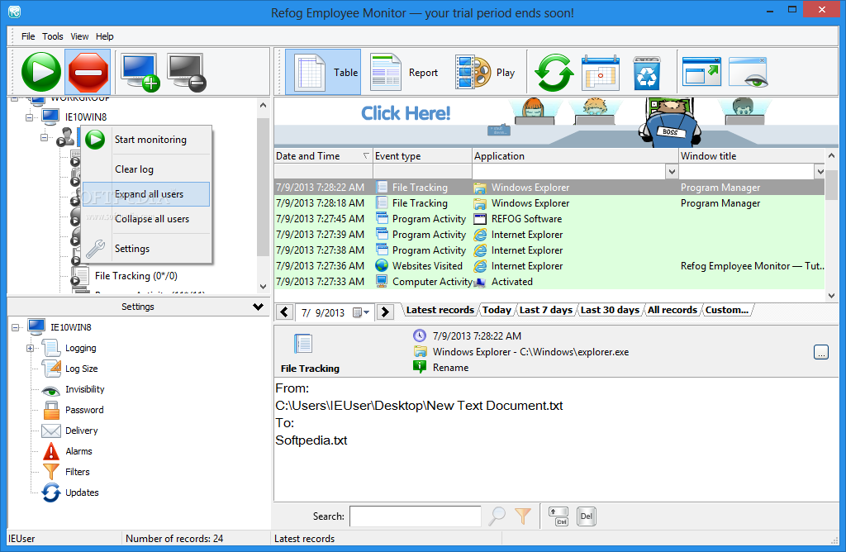
Refog Employee Monitor:
Desktop App.
Offers remote desktop.
Control some OS parameters.

Slide 10
TOOLS
Tools and technologies used in this app

Slide 11

Node JS:
Web server.
API.
Control local firewall for host computer.
Rendering user chatting page.

Slide 12

IONIC Framework:
Angular framework.
Connect to host computers.
Rendering app pages.
Handle app requests.

Slide 13
Team PLAN
Plan of work

Slide 14
Team Plan:

Slide 15
MEMBER ROLES
Individual work plan

Slide 16
Team Plan:
Ibrahim
Soaud
Base App
Get Ips
Control network
Ip page
Compiling ionic
Web server
API
Chat model
File model
Voice model
Compiling node

Slide 17
FIELD OF WORK
Problem solved with NCP

Slide 18
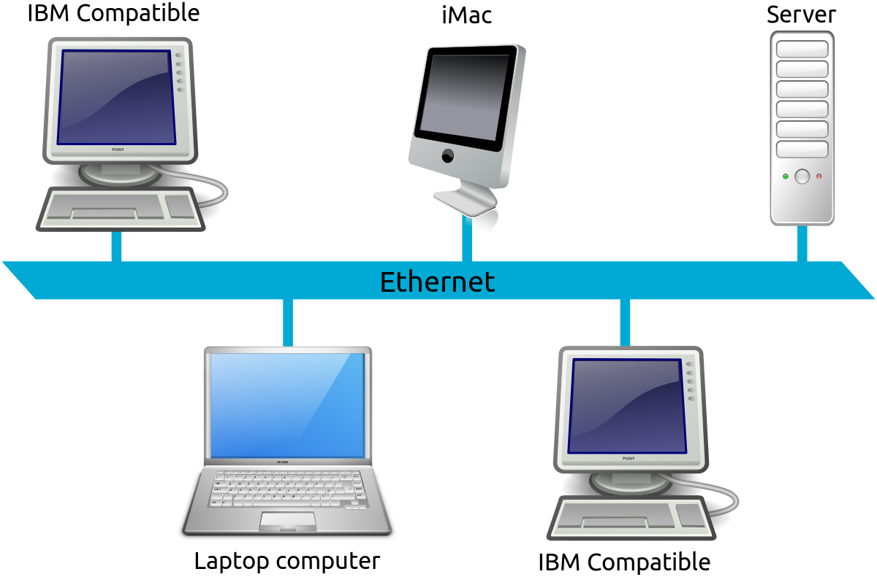
End User:
Companions.
Schools.
Home.
Cybercafé.

Slide 19
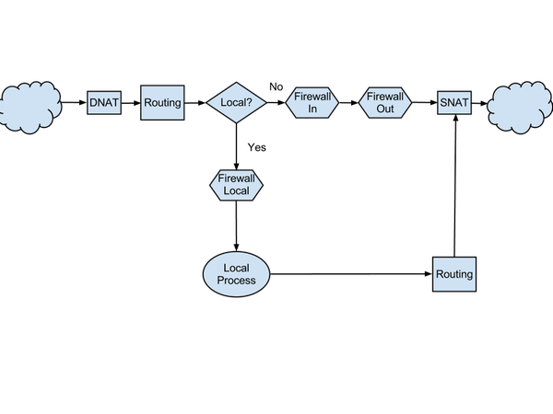
NCP Network Control feature:
Local firewall Vs router firewall.
Adding rule.
Removing rule.
netsh.

Slide 20
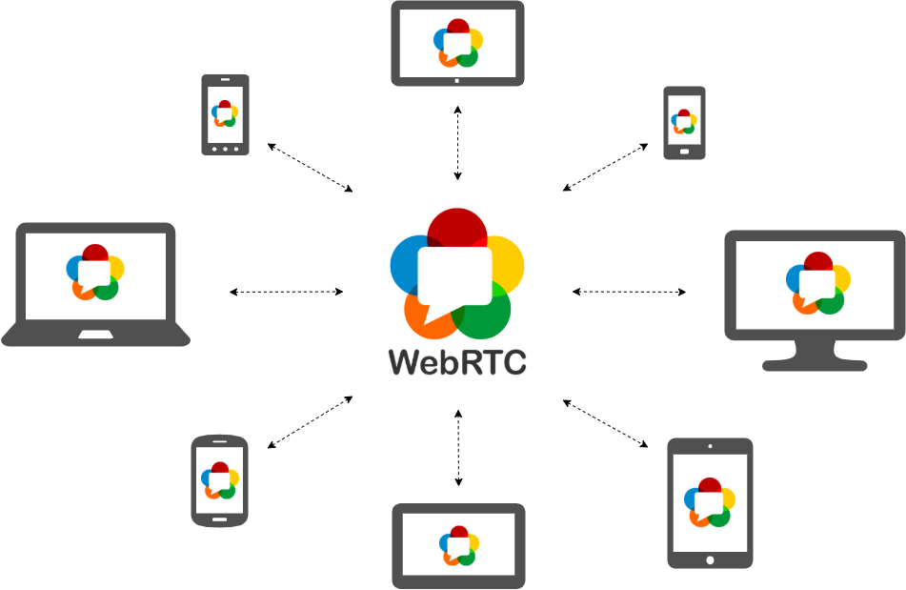
Voice streaming:
LANMIC
WebRTC.

Slide 21
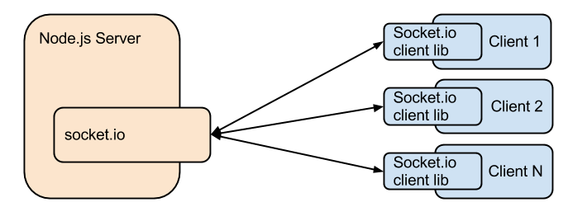
Text Messages:
NodeJS.
Express.
Socket.IO

Slide 22

File upload:
Multer.
<input type=“file” />

Slide 23
MAIN WORK
NCP program details

Slide 24

NCP & NETWORK CONTROLLER
NCP details.
Network controller app.
Code fragments.

Slide 25
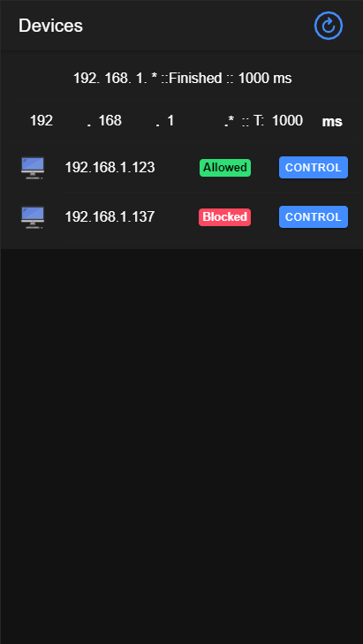
NEWTORK CONTROLLER:
IPS component.
IP component.
Message component.
Voice component.

Slide 26
IPS COMPONENT:
Controls GetWay.
Controls request timeout.
Show operation status.
Show live devices and their status.
Has a refresh button.

Slide 27
IP COMPONENT:
Info section.
Network access control.
Communication section.
File section.

Slide 28
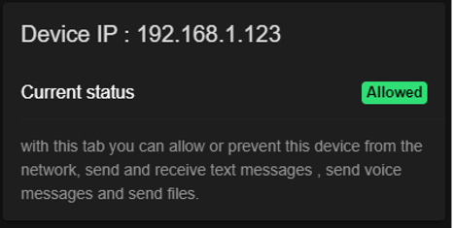
INFO SECTION:
Device Ip.
Current status.
Message to user.

Slide 29
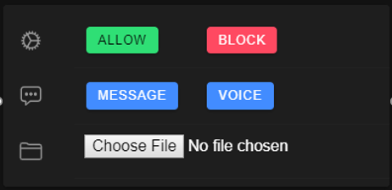
CONTROL SECTION:
Allow button.
Block button.
Message button.
Voice stream button.
File upload button.

Slide 30
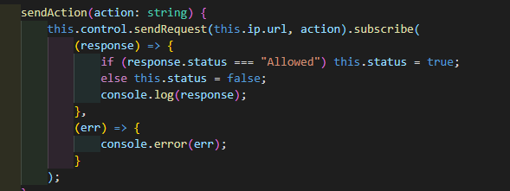

ALLOW & BLOCK:
Send action.
Send request.

Slide 31
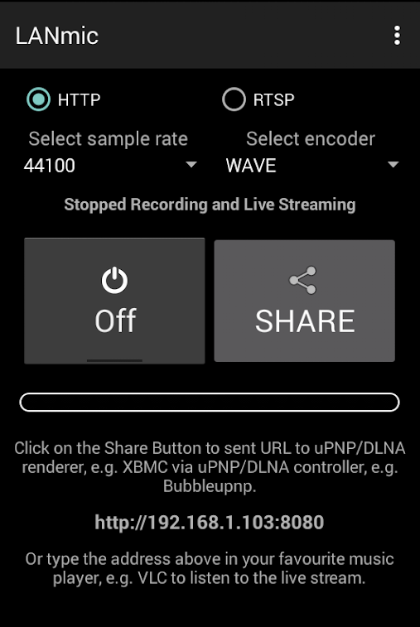
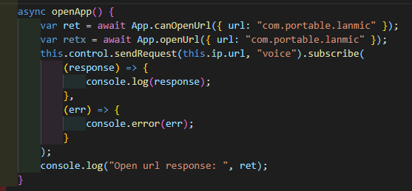
VOICE STREAM:
LANMIC .
Open app.

Slide 32
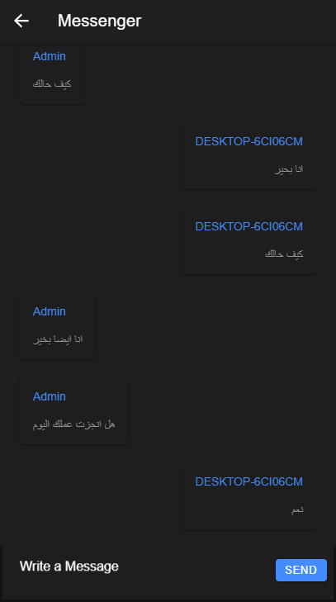
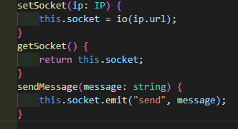
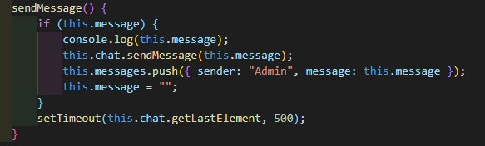
MESSAGE:
Socket.IO
Sender & message.
Send message.
Message storage (JSON).

Slide 33
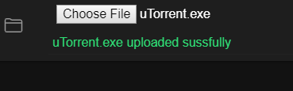
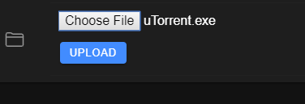
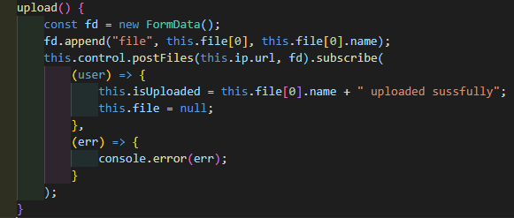
UPLOAD FILE BUTTON:
Before uploading.
After uploading.
Upload module.

Slide 34
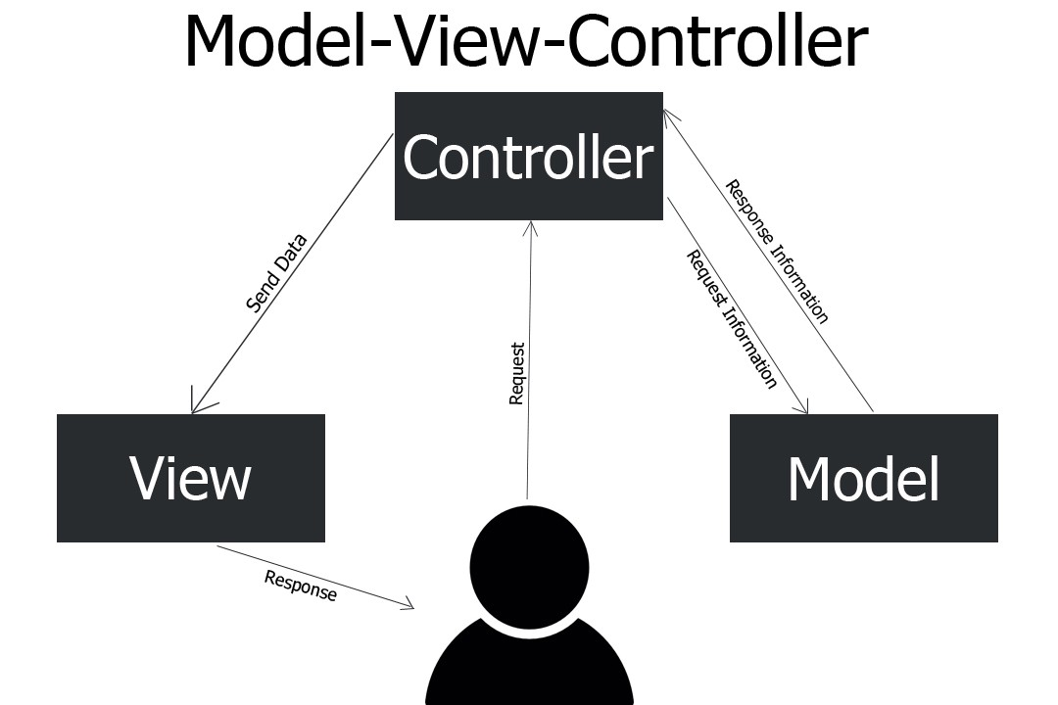
NCP:
MVC.
INTERNET-ACCESS.
FILE.
CHAT.

Slide 35
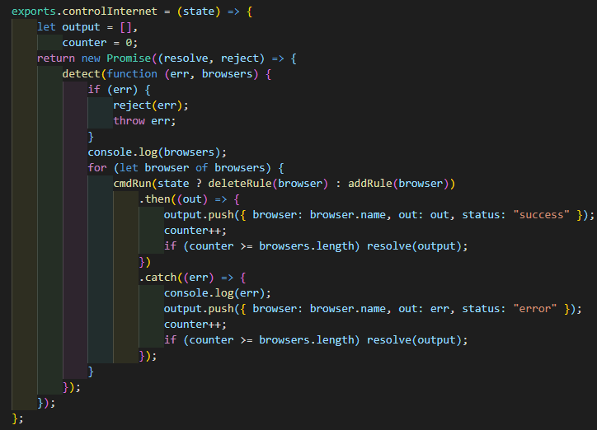
INTERNET-ACCESS:
Get installed browsers.
Allow.
Block.

Slide 36
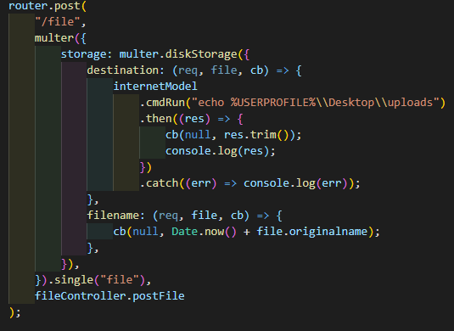
FILE:
Multer
Cmd
Get path to desktop.
File name.

Slide 37
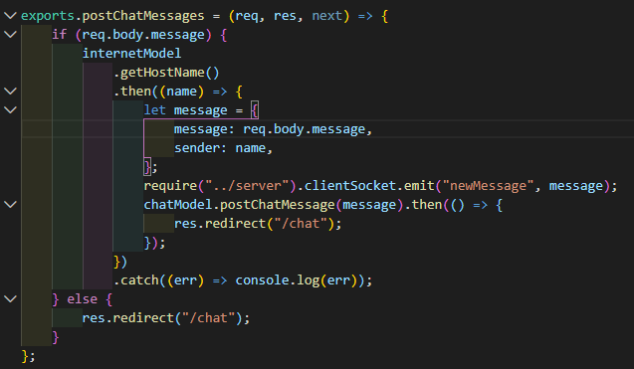
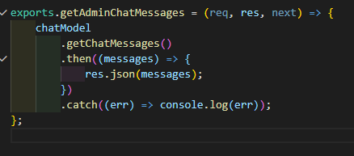
CHAT:
Send and save message.
Get all messages

Slide 38
Conclusion
Conclusion of the work

Slide 39
Future work
Features to be added in the future

Slide 40
Future work:
Voice chatting between two sides.
desktop view and control.
Firewall issue resolve for user installed firewall like Mcafee.
Windows home support without any need to enable gpedit.msc.
File collecting from the client to admin.
WEBRTC full communication protocols for video calls.
Screen recorder.
Specific links block.

Slide 41
REFRENCES
Don’t forget to review references

Slide 42
REFRENCES:
https://www.computerhope.com/netsh.htm
https://docs.microsoft.com/en-us/previous-versions/tn-archive/bb490939(v=technet.10)
https://doi.org/10.1145%2F253769.253802
http://www.cs.unm.edu/~treport/tr/02-12/firewall.pdfhttps://techcrunch.com/2014/03/10/drifty-makers-of-the-ionic-mobile-framework-raise-1-million/
https://blog.ionicframework.com/introducing-ionic-4-ionic-for-everyone/
https://venturebeat.com/2012/01/24/why-walmart-is-using-node-js/
https://www.cnet.com/news/netscape-opens-intranet-attack/
http://www.infoworld.com/article/2855057/application-development/why-iojs-decided-to-fork-nodejs.html
https://tools.ietf.org/html/rfc760
https://web.archive.org/web/20090323032904/https://www.artima.com/articles/dci_vision.html
http://blog.iandavis.com/2008/12/what-are-the-benefits-of-mvc/

Slide 43
Questions!!
Thanks for your time, any questions!

